Slide 1


GEETHANJALI INSTITUTE OF SCIENCE AND TECHNOLOGY Gangavaram(V),Kovur(M),Nellore(Dt),AndhraPradesh,India-524137Accredited with NAAC A , Affiliated to JNTU Anantapur
Street Lights that Glow on Detecting Vehicle Movement
UNDER THE GUIDANCE OF
Dr.P.RAHUL REDDY SIR
PRESENTED BY:
SK.ASIF-192U1A04D9
SK.KHAJA MOHIDDIN-192U1A04E3
SK.MOHAMMAD JAVAD-192U1A04E5
SK.MOHAMMAD TAJ-192U1A04E6

Slide 2
ABSTRACT
Generally, street lights are switched on for whole night and during the day, they are switched off. But during the night time, street lights are not necessary if there is no traffic. Saving of this energy is very important factor these days as energy resources are getting reduced day by day.
Alternatives for natural resources are very less and our next generations may face lot of problems because of lack of these natural resources. This article describes about the circuit that switches the street lights on detecting vehicle movement and remains off after fixed time.

Slide 3

CONTENTS
INTRODUCTION
BLOCK DIAGRAM
WORKING PRINCIPLE
CIRCUIT COMPONENTS
CIRCUIT DIAGRAM
APPLICATIONS
ADVANTAGES
CONCLUSION

Slide 4
INTRODUCTION
To promote energy efficiency and balanced use of energy resources
To endorse renewable, and new sources and to upkeep energy variation
To encourage energy proficiency and use new and renewable source in the transport

Slide 5
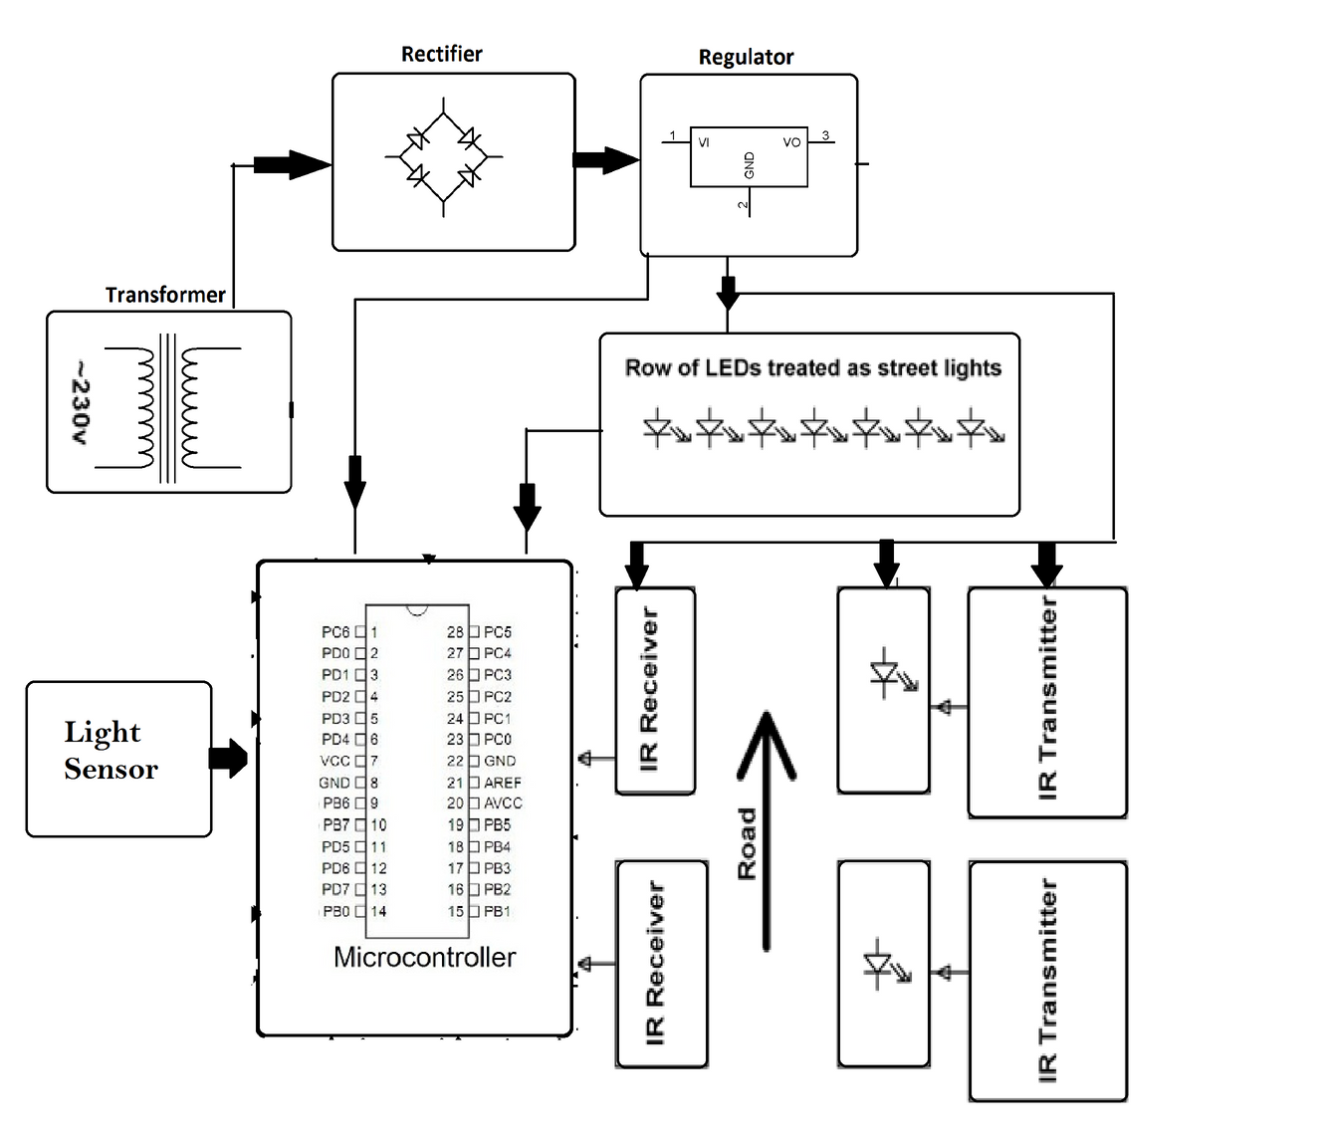
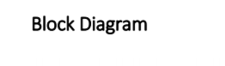

Slide 6
WORKING PRINCIPLE
The proposed system consists of Atmega8 microcontroller, LDR, PIR sensor and RTC. This system controls the street lights using light dependent resistor and PIR sensor. Street lights are switched on depending on the intensity of the Sun light on LDR. If the intensity of Sunlight on light dependent resistor is low, its resistance value is high. This value increases and becomes high when it is completely in dark. This resistance value decides when the street lights are required to switch ON. As the resistance value is maximum in the midnights, real time clock comes into the play. The controller checks peak time during which there is no traffic and switch OFF the lights. When there is any vehicle on the road, it is detected by the PIR sensor.

Slide 7
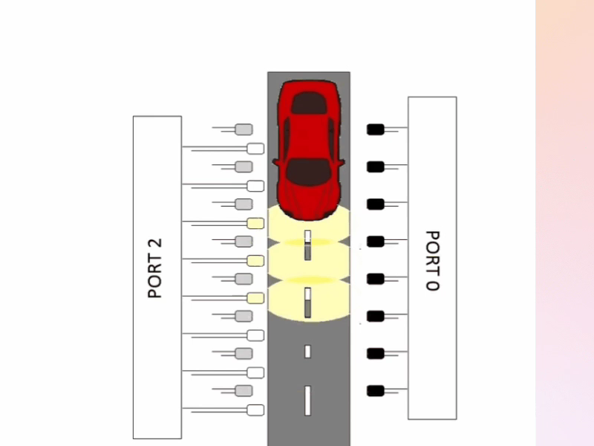

Slide 8
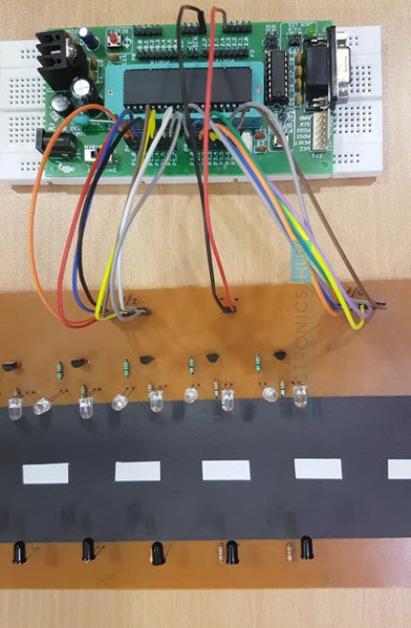
CIRCUIT COMPONENTS
ATmega8 microcontroller
DS1307 IC
PIR sensor
LDR
LCD
LED array

Slide 9
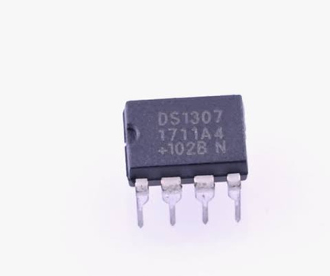
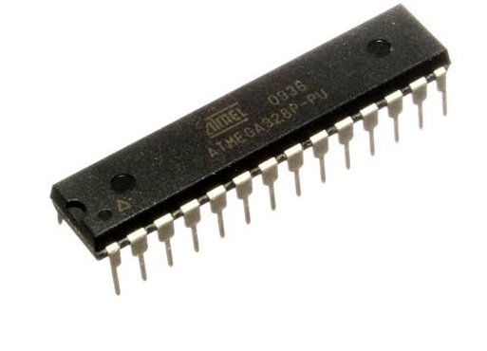
Atmega8 controller
DS 1307 IC
The ATmega8 is a low-power CMOS 8-bit microcontroller based on the AVR RISC architecture
The DS1307 serial real-time clock (RTC) is a low- power, full binary-coded decimal (BCD) clock/calendar plus 56 bytes of NV SRAM

Slide 10
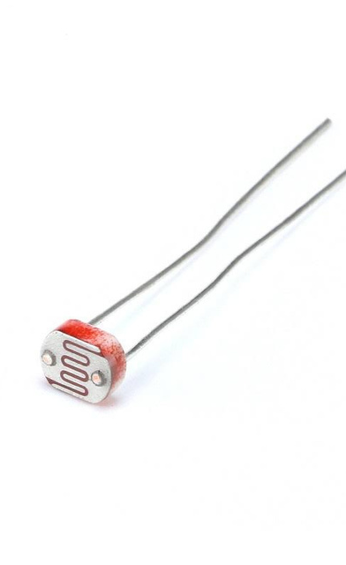
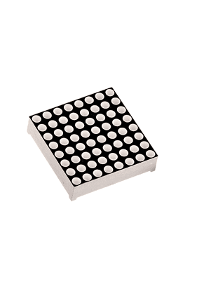
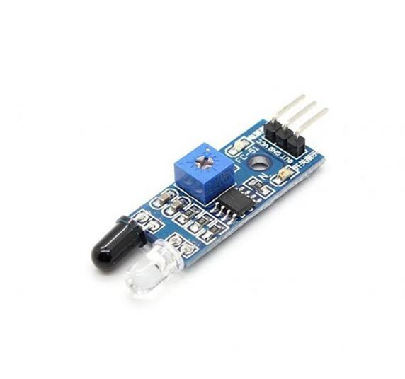
IR Sensor
LDR
LED Array
An infrared sensor (IR sensor) is a radiation-sensitive optoelectronic component with a spectral sensitivity in the infrared wavelength range 780 nm … 50 µm.
LED arrays are assemblies of LED packages or dies that can be built using several methods.
An LDR is a component that has a (variable) resistance that changes with the light intensity that falls upon it.

Slide 11
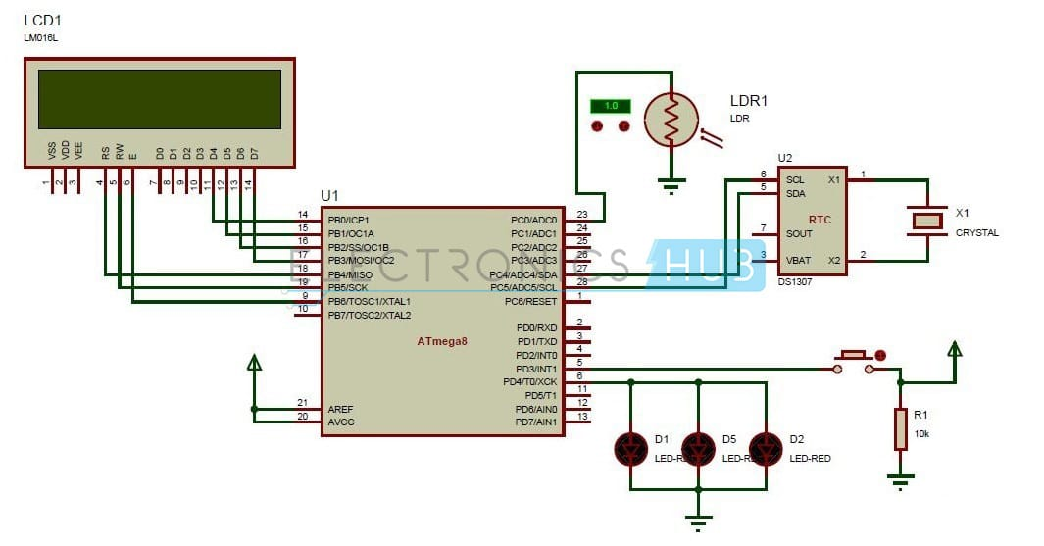
CIRCUIT DIAGRAM

Slide 12
APPLICATIONS
This street light control circuit can be used in normal roads, highways, express ways etc.
This project can also be used in parking areas of malls, hotels, industrial lighting, etc.

Slide 13
ADVANTAGES
If the lighting system implements all LED lights, the cost of the maintenance can be reduced as the life span and durability of LEDs is higher than Neon based lights which are normally used as street lights.
As the lights are automatically turned ON or OFF, huge amount of energy can be saved.

Slide 14
CONCLUSION
This project of AUTOMATIC STREET LIGHTS is a cost effective, practical, ecofriendly and the safest way to save energy.
It clearly tackles the two problems that world is facing today, saving of energy and also disposal of incandescent lamps, very efficiently.

Slide 15
Thank you!
Let us know if you have questions or clarifications.

